Slide 1
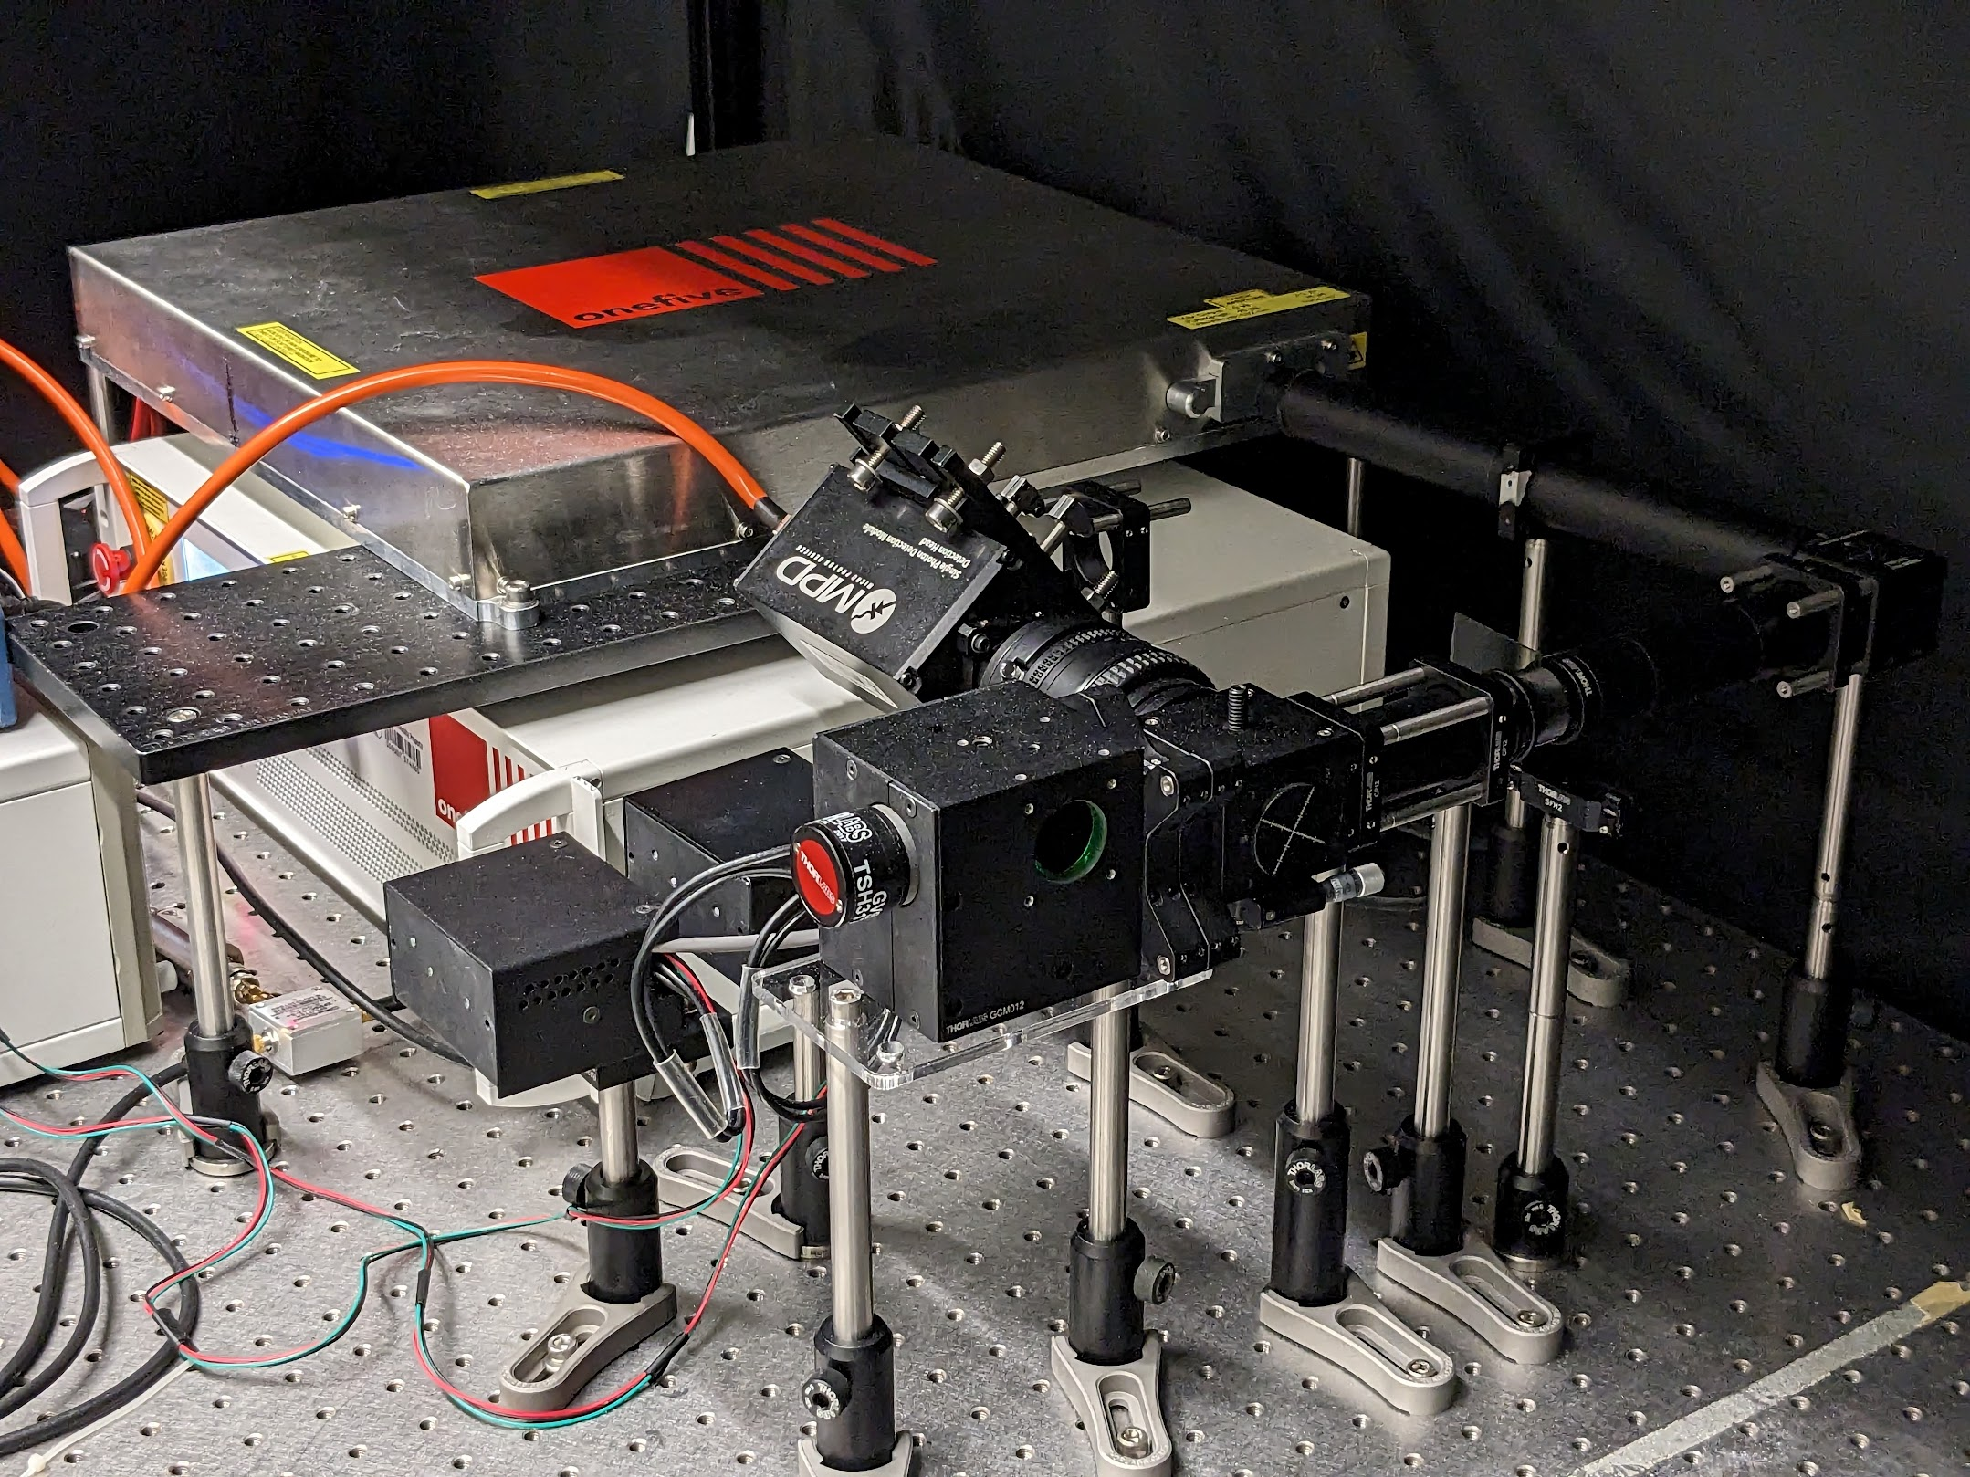
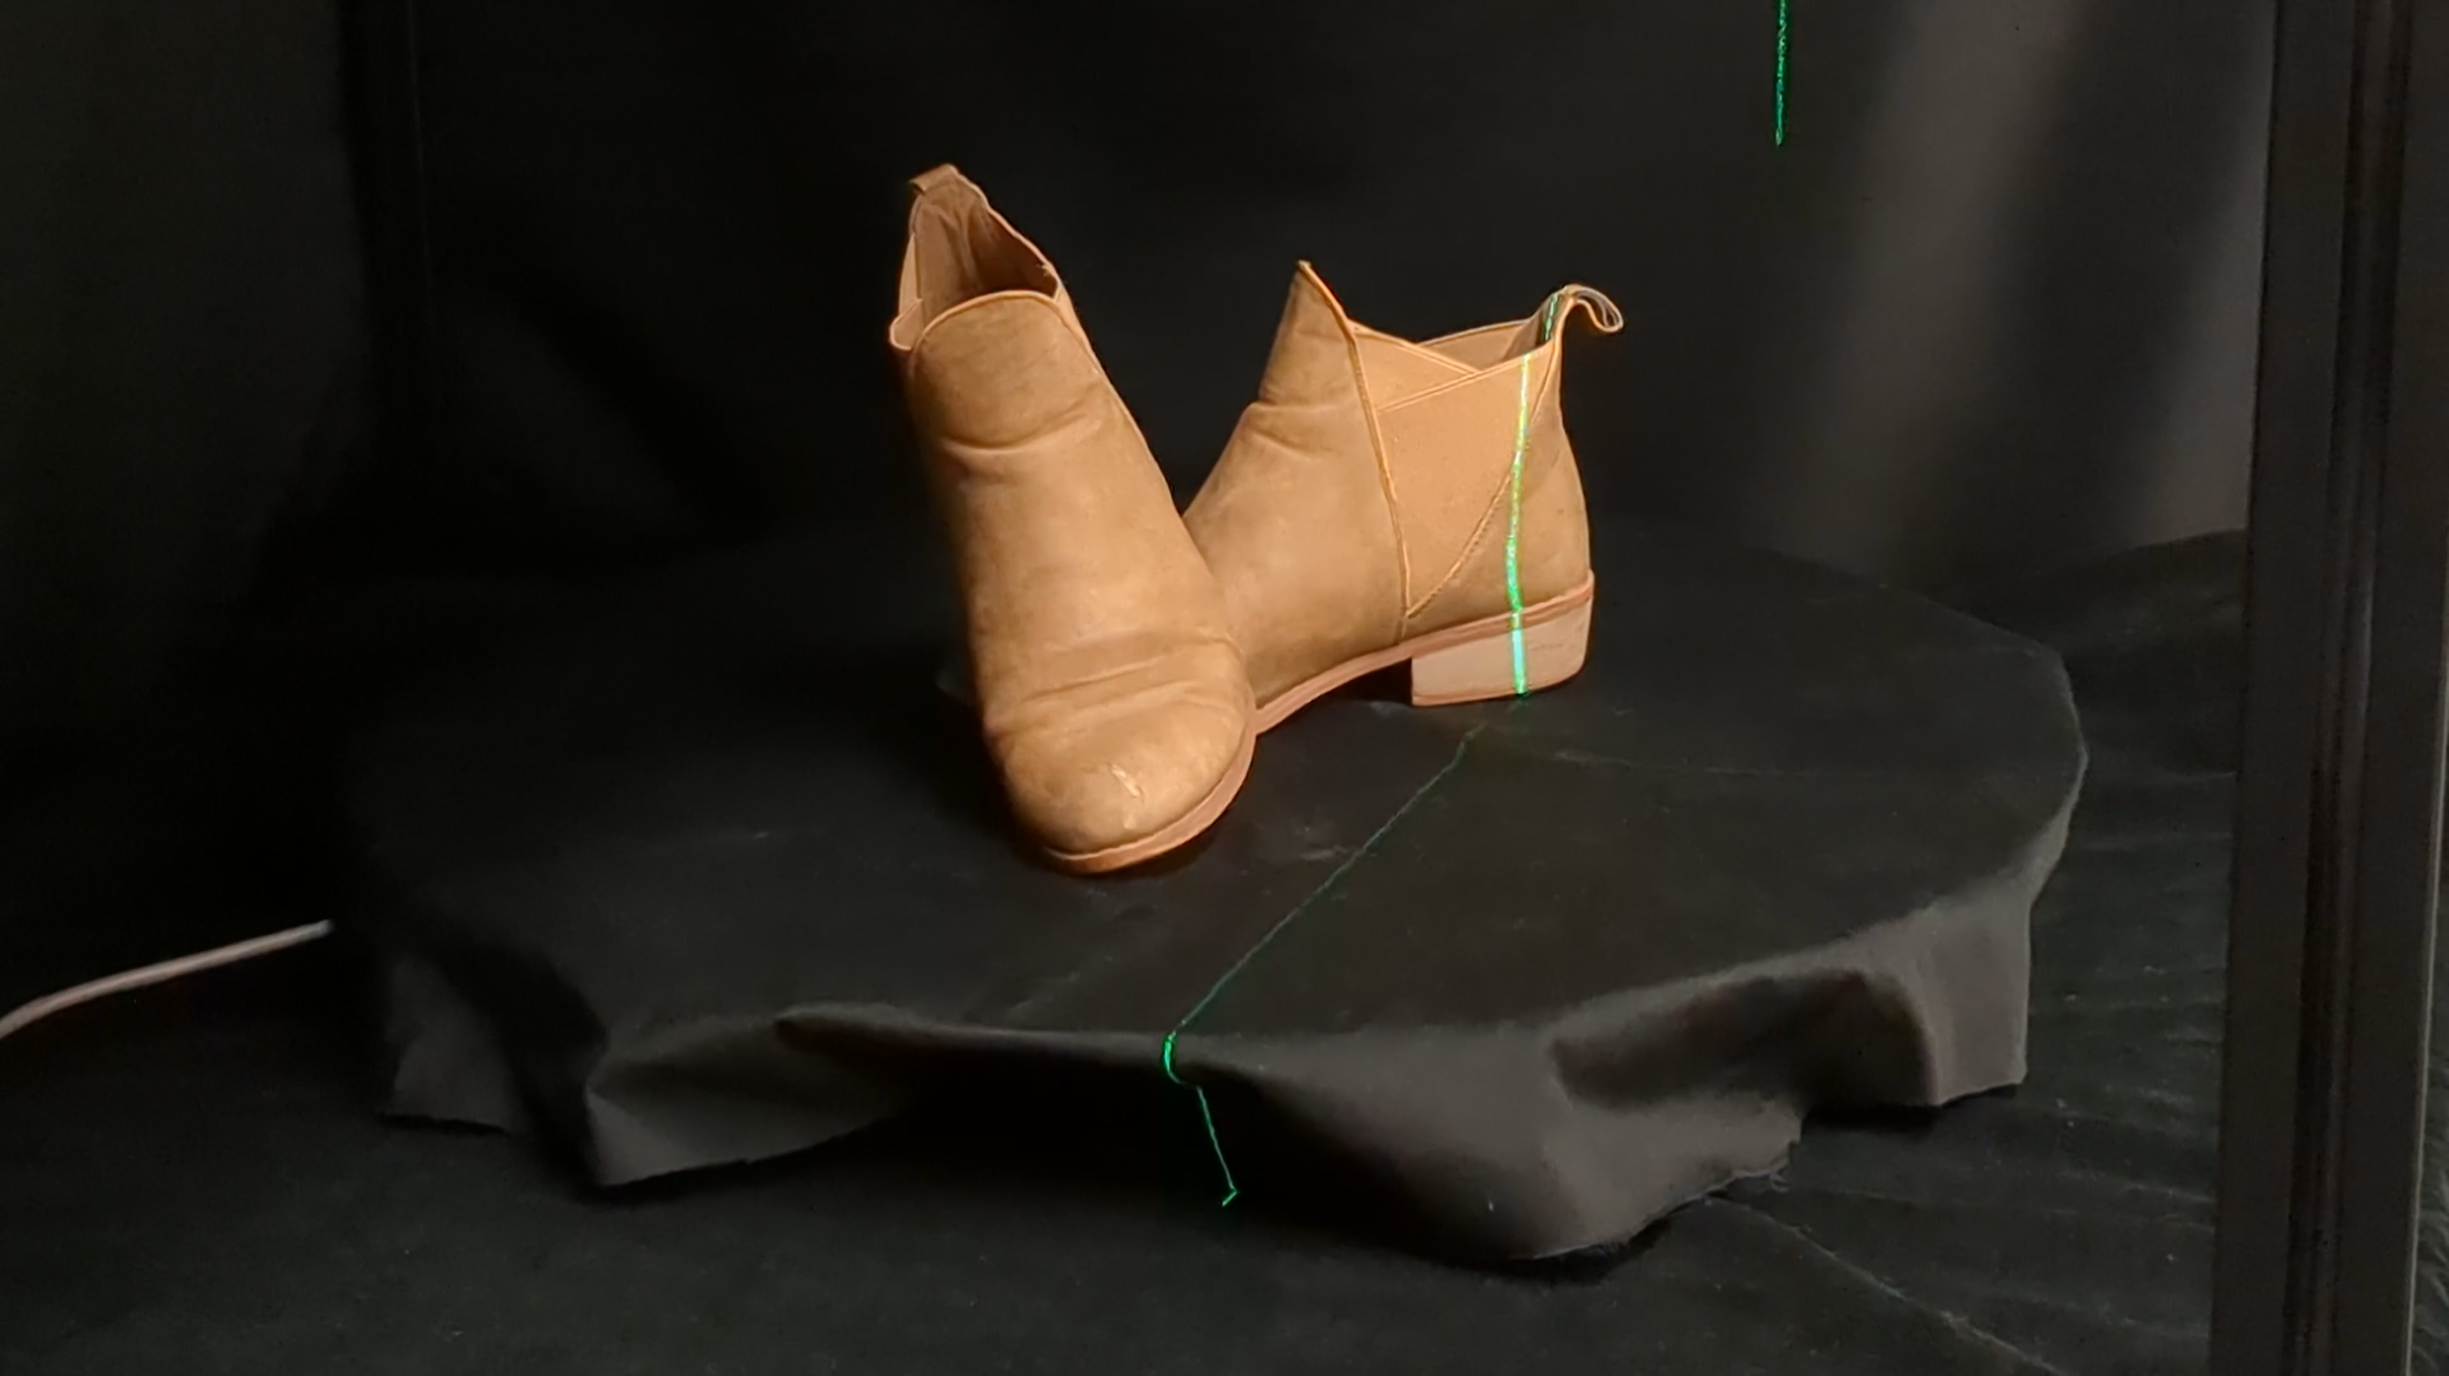
single-photon lidar system
scene on top of a rotation stage
single-photon
avalanche diode
scanning mirrors
picosecond laser
Notes:
We also test our method on a dataset we capture using our prototype single photon lidar system shown on the left. The hardware system contains a picosecond laser that shares an optical path with a single-photon avalanche diode. We scan the scene using two-axis scanning mirrors. The scenes are mounted on a rotation stage to facilitate multiview scanning.

